Slide 1

MATH30
Probability and Statistics

Slide 2

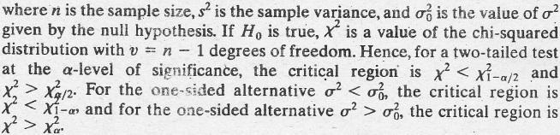
One- and Two-Sample Tests Concerning Variances
H₀: The population variance σ² equals a specified value σ₀².
H1: σ² < σ₀², σ² > σ₀², or σ² ≠ σ₀².
Chi-squared value for testing σ² = σ₀² :

Slide 3
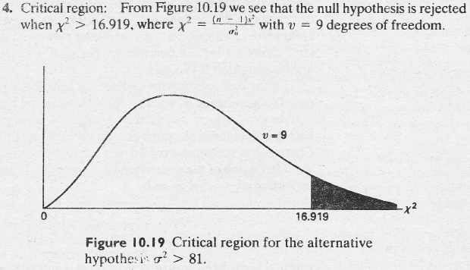

One- and Two-Sample Tests Concerning Variances
Example 10.13 A manufacturer of car batteries claims that the life of his batteries is approximately normally distributed with a standard deviation equal to 0.9 year. If a random sample of 10 of these batteries has a standard deviation of 1.2 years, do you think that σ > 0.9 year? Use 0.05 level of significance.
Solution:

Slide 4
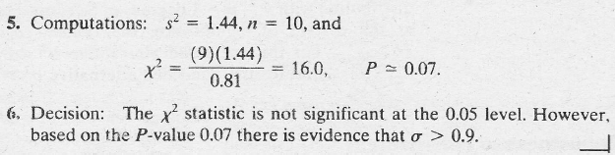
One- and Two-Sample Tests Concerning Variances

Slide 5
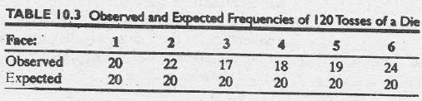
Goodness-of-Fit Test
Suppose that a die is tossed 120 times and each outcome is recorded. Theoretically, if the die is balanced, we would expect each face to occur 20 times. The results are given in Table 10.3.
By comparing the observed frequencies with the corresponding expected frequencies, we must decide whether these discrepancies are likely to occur as a result of sampling fluctuations and the die is balanced or the die is not honest and the distribution of outcomes is not uniform. IT is common practice to refer to each possible outcome of an experiment as a cell. Hence, in our illustration, we have 6 cell.s

Slide 6
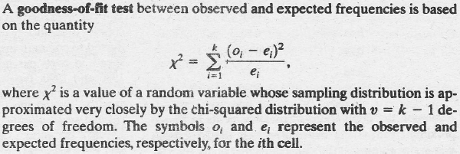
Goodness-of-Fit Test
Goodness-of-fit test

Slide 7
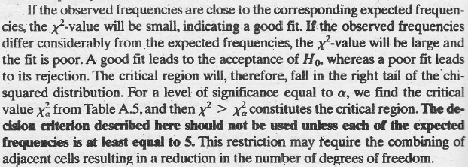
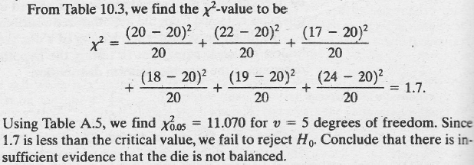
Goodness-of-Fit Test

Slide 8
Goodness-of-Fit Test

Slide 9
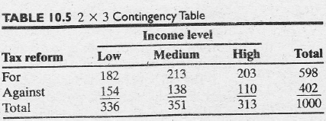
Test for Independence (Categorical Data)
Suppose that we wish to determine whether the opinions of the voting residents of the state of Illinois concerning a new tax reform are independent of their levels or income. A random sample of 1000 registered voters from the state of Illinois are classified as to whether they are in a low, medium, or high income bracket and whether or not they favor a new tax reform. The observed frequencies are presented in Table 10.5, which is known as a contingency table.

Slide 10

Test for Independence (Categorical Data)
A contingency table with r rows and c columns is referred to as an r ×c table (“r × c” is read “r by c”). The row and column totals in Table 10.5 are called marginal frequencies. Our decision is to accept or reject the null hypothesis, H₀, of independence between a voter’s opinion concerning the new tax reform and his or her level of income is based upon how good a fit we have between the observed frequencies in each of the 6 cells of Table 10.5
The general rule for obtaining the expected frequency if any cell is given by the following formula:

Slide 11

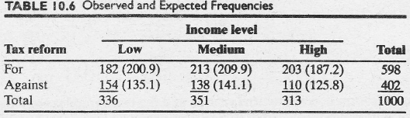
Test for Independence (Categorical Data)
Example:
The expected number of low-income voters in our sample who favor the new tax reform is estimated to be
To summarize

Slide 12
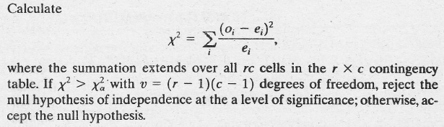
Test for Independence (Categorical Data)
A simple formula providing the correct number of degrees of freedom is
To test the null hypothesis of independence, we use the following decision criterion:
Test for independence

Slide 13
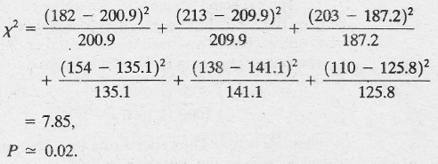

Test for Independence (Categorical Data)
Applying the criterion to our example, we find that

Slide 14
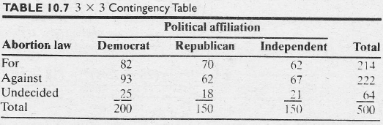
Test for Homogeneity
Suppose, for example, that we decide in advance to select 200 Democrats, 150 Republicans , and 150 Independents from the voters of the state of Carolina and record whether they are for a proposed abortion law, against it, or undecided. The observed responses are given in Table 10.7

Slide 15
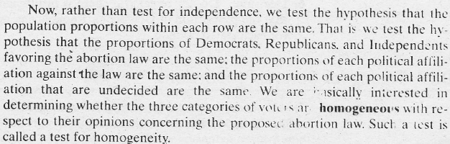
Test for Homogeneity

Slide 16
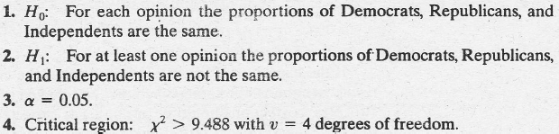
Test for Homogeneity
Example 10.15 Referring to the data of Table 10.7, test the hypothesis that the opinions concerning the proposed abortion of law are the same within each political affiliation. Use a 0.05 level of significance.
Solution:

Slide 17

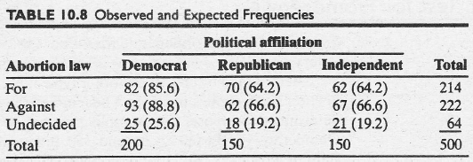
Test for Homogeneity

Slide 18
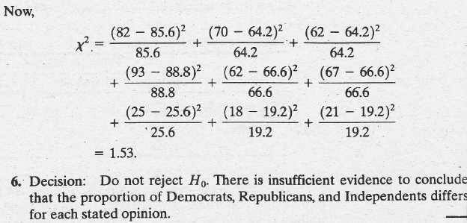
Test for Homogeneity

